Slide 1

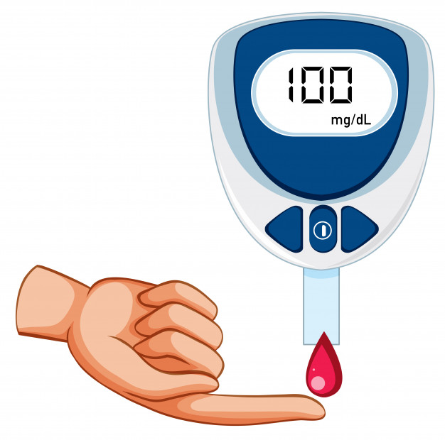



GLUCOSE LEVEL
HYPERTENSION
STROKE PREDICTION
HEART DISEASE
SMOKING

Slide 2
PROJECT MEMBERS
1.PRIYANKA KHOT:-SS2021449
2.SHREYASH MHASKAR:-SS2021456
3.PRIYANKA MANDYA:-SS2021462
4.ISHIKA SHETTY:-SS2021469
5.PRANJAL SHINDE:-SS2021470
6.DHIRAJ POOJARY:-SS2021480

Slide 3










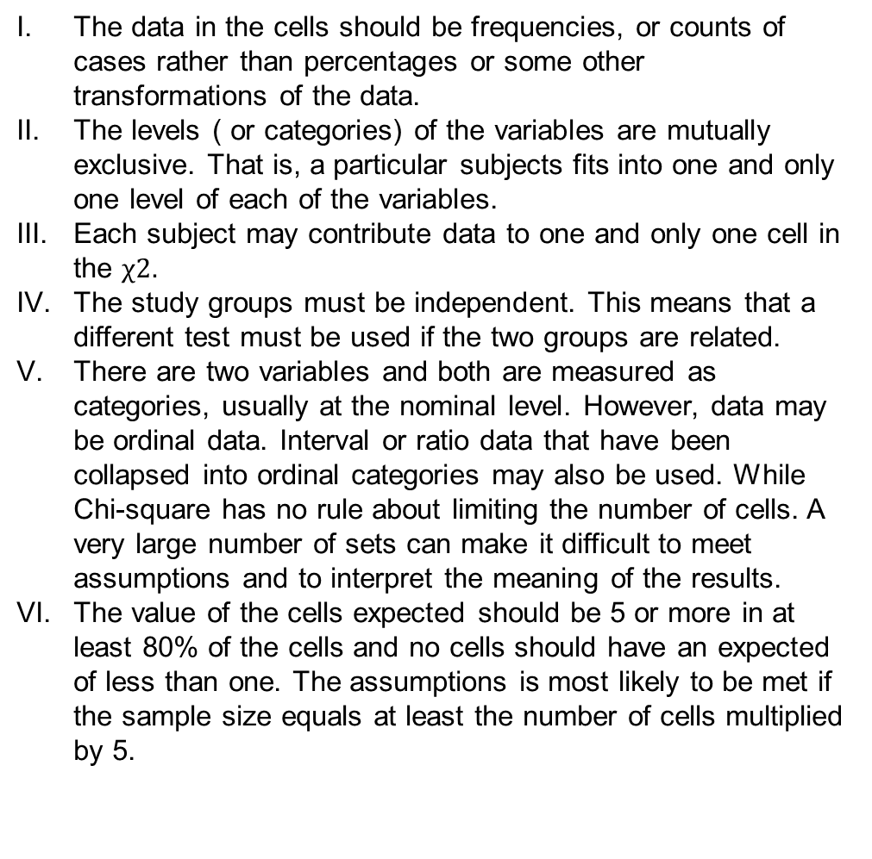
Assumptions
CHI SQUARE TEST
SIGNIFICANCE OF T TEST
The data in the cells should be frequencies, or counts of cases rather than percentages or some other transformations of the data.
The levels ( or categories) of the variables are mutually exclusive. That is, a particular subjects fits into one and only one level of each of the variables.
Each subject may contribute data to one and only one cell in the $χ2.$
The study groups must be independent. This means that a different test must be used if the two groups are related.
There are two variables and both are measured as categories, usually at the nominal level. However, data may be ordinal data. Interval or ratio data that have been collapsed into ordinal categories may also be used. While Chi-square has no rule about limiting the number of cells. A very large number of sets can make it difficult to meet assumptions and to interpret the meaning of the results.
The value of the cells expected should be 5 or more in at least 80% of the cells and no cells should have an expected of less than one. The assumptions is most likely to be met if the sample size equals at least the number of cells multiplied by 5.
The dependent variable must be continuous (interval/ratio).
The observations are independent of one another.
The dependent variable should be approximately normally distributed.
The dependent variable should not contain any outliers
The population variances are equal

Slide 4
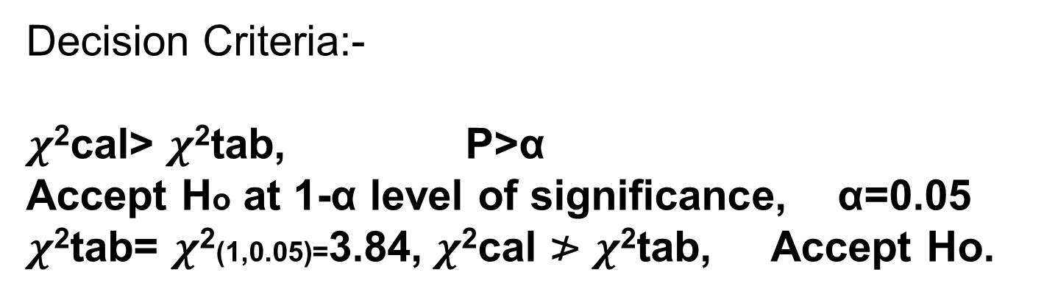
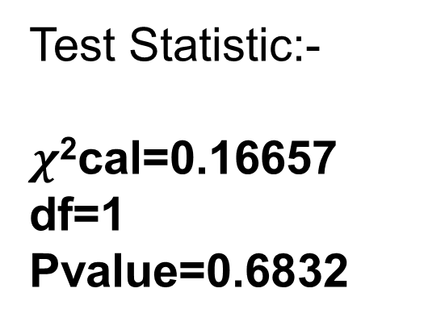
Chi square relation between Gender & STROKE
HYPOTHESIS:-
Ho:-Gender and Getting a Stroke are Independent
H1:- Gender and Getting a Stroke are Dependent
Test Statistic:-
$χ$²cal=0.16657
df=1
Pvalue=0.6832
Decision Criteria:-
$χ$²cal> $χ$²tab, P>α
Accept Ho at 1-α level of significance, α=0.05
$χ$²tab= $χ$²(1,0.05)=3.84, $χ$²cal ≯ $χ$²tab, Accept Ho.
Therefore, Gender and Getting a Stroke are Independent.

Slide 5
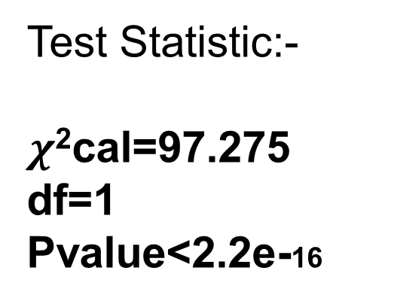
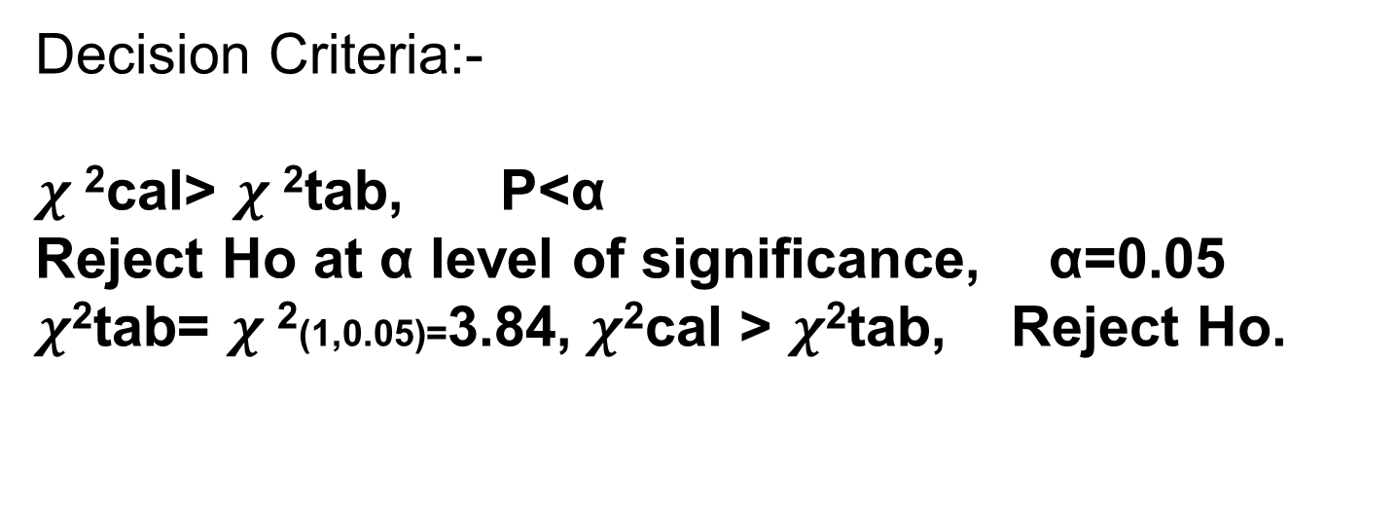
CHI square relation between hypertension & Stroke
HYPOTHESIS:-
Ho:-Hypertension and Stroke are Independent
H1:- Hypertension and Stroke are Dependent
Test Statistic:-
$χ$²cal=97.275
df=1
Pvalue<2.2e-16
Decision Criteria:-
$χ$²cal> $χ$²tab, P<α
Reject Ho at α level of significance, α=0.05
$χ$²tab= $χ$²(1,0.05)=3.84, $χ$²cal > $χ$²tab, Reject Ho.
Therefore, Hypertension and Stroke are Dependent.

Slide 6

To test Significance of gender and BMI Means
Hypothesis:-
Ho:-Mean BMI in Male and Female is same
H1:-Mean BMI in Male and Female is not same
Test Statistic:-
tcal=1.6304
df=4499
Pvalue=0.1031
Decision Criteria:-
tcal≯ttab, P≮α
Accept Ho at 1-α level of significance, α=0.05
ttab= tα/2(n-1)=1.960, tcal ≯ ttab, Accept Ho
Therefore, Mean BMI in Male and Female is same.

Slide 7
To test Significance of gender and Avg glucose level Means
Hypothesis:-
Ho:-Mean Avg glucose level in Male and Female is same
H1:-Mean Avg glucose level in Male and Female is not same
Test Statistic:-
tcal=0
df=4996
Pvalue=1
Decision Criteria:-
tcal<ttab, P>α
Accept Ho at 1-α level of significance, α=0.05
ttab= tα/2(n-1)=1.960, tcal < ttab, Accept Ho
Therefore, Mean Avg Glucose level in Male and Female is same.

Slide 8

Two way Anova
Factors:
Factor A: Working Class
Factor B:Smoking Status
Mathematical Model:
$$yij=μ+αi+βj+eij$$
α=Effect of Working Class on Glucose Level
β=Effect of Smoking Status on Glucose level
Hypothesis:-
HoA:α1=α2=……=0 V/S H1A: Not HoA
HoB:β1=β2=……=0 V/S H1B: Not HoB
Decision Criteria:-
If Fcal > Ftab Reject Ho
F1cal=16.6726 F1tab=1.401e-13
F2cal=8.4253 F2tab=1.393e-05
∴ Fcal > Ftab Reject Ho
Conclusion:-
Different working classes have different level of glucose and people with different smoking status have different level of glucose.

Slide 9
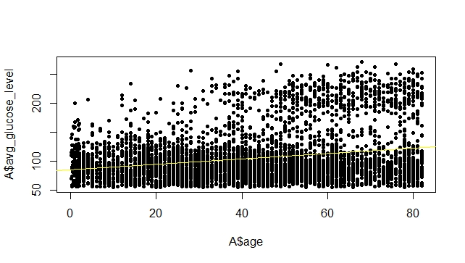
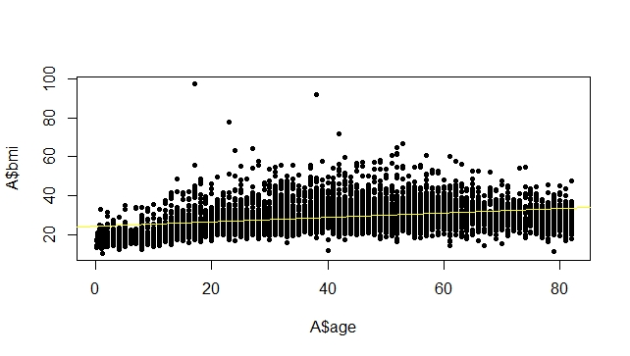
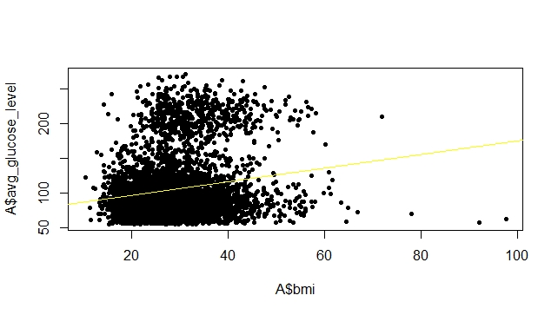
Regression Analysis | Intercept | Correlation Coefficient (r) | Scatter Plot Diagram | Conclusion
X=Age Y=Avg Glucose Level | 85.3940 | 0.2358382 |  | Age and Avg Glucose Level are positively correlated
X=Age Y=BMI | 23.9168 | 0.333398 |  | Age and BMI are positively correlated
X=BMI Y=Avg Glucose Level | 76.6234 | 0.1755022 |  | BMI and Avg Glucose Level are positively correlated
Therefore, Age, Avg Glucose Level, BMI are All Positively Correlated.

Slide 10
CONCLUSION
The onset of stroke is a dramatic and discouraging event both for the person having the stroke and their family. A person may go from complete independence to complete dependence in a matter of minutes.
Medical care for stroke survivors is often fragmented and inconsistent. In some cases the patient is moved quickly from the acute hospital to a skilled nursing facility or an inpatient rehab department for rehabilitation.
“Your body can stand almost anything. It's your mind that you have to convince."

